Slide 1

Topics
•
Arrays
in
Java
1
Object-Oriented Programming Using Java

Slide 2
Arrays Introduction
•
•
•
Array → Collection of Homogeneous Data Elements
Arrays are objects and implements only static (fixed-length) arrays
Java follows strict bound checking for referencing array elements. If an attempt is made to reference the elements outside the bounds then “ArrayIndexOutOfBoundsException” will be thrown at run time.
•
Arrays
can
be
1-dimensional
(1-D),
2-dimensional (2-D) or
multidimensional.
Maximum Dimensions an Array can have = 255
•
•
Arrays
are
Objects
in
Java.
So,
every
element
at
each
index
is
automatically initialized to some default value depending upon the type
of array. [byte, short, int and long → 0, float, double → 0.0, booelan →
false, char → ‘’ (whitespace) and any class type array → null]
<<length>> is the attribute of each array which can be referenced by
<array-reference-name> . <length>
•
2
Object-Oriented Programming Using Java

Slide 3
1-dimensional Arrays
Syntax : One-Dimensional Arrays :
type[ ] arrayname = new
type[Size];
or
type arrayname[ ] = new
type[Size];
Examples :
1. int[ ] marks = new int[10];
marks is an int type array,
// Each element is initialized to 0
marks.length = 10, LB index =0 , UB index = 9
// Each element is initialized to 0.0
2.
float[ ] values = new float[20];
values is an float type array,
double cgpa[ ] = new double[5];
values.length = 20, LB index =0 , UB index =19
// Each element is initialized to 0.0
3.
cgpa is double type array, cgpa.length = 5, LB index =0 , UB index = 4
4.
Box[ ] boxes = new Box[20];
// Each element is initialized to ‘null’ value
boxes is a Box type array, boxes.length = 20, LB index =0 , UB index = 19
5.
Point points[ ] = new Point[20];
// Each element is initialized to ‘null’ value
points is a Point type array, points.length = 20, LB index =0 , UB index =19
int[] marks = {10, 8, 6, 34, 0, 34};
marks is a int type array, marks.length = 6, LB index = 0, UB index = 5
6.
3
Object-Oriented Programming Using Java

Slide 4
2-dimensional Arrays
Syntax : Two-Dimensional Arrays :
type[ ][ ] arrayname = new
type[Row_Size][Col_Size];
or
type arrayname[ ][ ] = new
Row index varies from 0 to Row_Size – 1
Column index varies from 0 to Col_Size – 1
Examples :
type[Row_Size][Col_Size];
1. int[ ][ ] data = new int[3][3];
// Each element is initialized to 0
data is 2-D int array, capacity = 9, row index 0 to 2 col index 0 to 2
2. float values[][] = new float[10][4];
// Each element is initialized to 0.0
values is 2-D float array, capacity = 40, row index 0 to 9 col index 0 to 3
3. int table[][] = {{ 0,0,0},{1,1,1}}; // initializes first row to 0 & second to 1
4
Object-Oriented Programming Using Java

Slide 5
2-dimensional Arrays ….
• Java treats a 2-D array as a collection of 1-D arrays.
• In two-dimensional arrays, individual rows can have variable number of
elements <Variable Size Array>
• Example
int[][] data = new int[4][];
// Variable-Size Array, column-size not mentioned
data is a 2-D array having 4 rows (row-index varies from 0 to 3)
data[0] = new int[10];
data[1] = new int[5]; data[2] = new int[6]; data[3] = new int[10];
// Row-0 has 10 elements, column-index varies from 0 to 9
// Row-1 has 5 elements, column-index varies from 0 to 4
// Row-2 has 6 elements, column-index varies from 0 to 5
// Row-3 has 10 elements, column-index varies from 0 to 9
data[1][6] →
Results in ArrayIndexOutofBounds Exception
data[2][6] →
Results in ArrayIndexOutofBounds Exception
5
Object-Oriented Programming Using Java

Slide 6
Referring Array Elements
•
1-D
Arrays,
Syntax →
array-name[<index>],
where
<index>
varies from 0
(LB) to array-name.length-1(UB)
•
2-D
Arrays,
Syntax
→
array-name[<row-index>][<col-index],
where <row-index> varies from 0 to no-of-rows -1, and <col-
index> varies from 0 to no-of-cols -1.
Example
•
1.
2.
3.
4.
int[] data = new int[5] ;
boolean[] flags = new boolean[10];
data[0] = 0; ….., data[4] = 0;
flag[0] = false, ….., flags[9] = false names[0]=null, …..., names[4] = null
String[]
double[]
names = new String[5];
values = {10.5, 5.6, 7.5, 4.5};
values[0] = 10.5, values[1] = 5.6, values[2] = 7.5, values[3] = 4.5
5.
int [][] marks = {{10,40,20},{25,56,57},{10,89,94}}
marks[0][0] = 10,
marks[1][0] = 25, marks[2][0] = 10,
marks[0][1] = 40,
marks[1][1] = 56, marks[2][1] = 89,
marks[0][2] =
marks[1][2] =
marks[2][2] =
20,
57,
94
6
Object-Oriented Programming Using Java

Slide 7
Displaying 1-D Array Elements
•
Two Methods
❑ Method
1: Using for { ..
} loop
Example :
int for(int
Variable
automatically
considered
is
data[]
= {10,6,8,9,-4,5};
as
of
i=0; i<data.length; i++)
System.out.println(data[i]);
‘int’ type The same
variable is to be
used inside the loop
❑ Method 2: Using for each loop
Syntax :
for(<type-of-array> <variable> : <array-name>)
Example :
int
for(int
data[] = {10,6,8,9,-4,5};
i : data)
System.out.println(i);
7
Object-Oriented Programming Using Java

Slide 8
Displaying 1-D
: Example 1
Array Elements
// File Name : Demo.java
class Demo
{
<<OUTPUT>>
public
{
static
void
main(String[] args)
Output by Method 1
false
false
false
false
false
Output by Method 2
false
false
false
false
false
boolean[]
flags =
new
boolean[5];
// Method-1 : Using for loop
System.out.println(“Output by Method 1”);
for(int i =0; i < flags.length; i++)
System.out.println(flags[i]);
// Method-2 : Using for each loop
System.out.println(“Output by Method 2”);
for(boolean k : flags)
System.out.println(k);
}// End of Method
}// End of class Demo
8
Object-Oriented Programming Using Java

Slide 9
Displaying 1-D
: Example 2
Array Elements
// File Name : Demo.java
class Demo
{
public
{
static
void
main(String[] args)
F:\>java Demo
Output by Method 1
null
null
null
null
null
Output by Method 2
null
null
null
null
null
String[]
names =
new String[5];
// Method-1 : Using for loop
System.out.println("Output by Method 1");
for(int i =0; i < names.length; i++)
System.out.println(names[i]);
// Method-2 : Using for each loop
System.out.println("Output by Method 2");
for(String k : names)
System.out.println(k);
}// End of Method
}// End of class Demo
9
Object-Oriented Programming Using Java

Slide 10
Displaying 2-D Array Elements
•
Two Methods
❑ Method
1: Using nested for { .. }
loop
Example :
int
data[][]
= new
int[5][5];
System.out.println(data.length);
for(int i=0; i<data.length; i++)
for(int j=0; j<data[i].length;
// Displays
5 not 25
// data.length = no of rows
// each jth column under ith row
j++)
System.out.println(data[i][j]);
❑ Method 2: Using nested for each loop
Syntax :
for(<type-of-array> [ ] <variable-i> : <array-name>)
for(<type-of-array> <variable-j> : <variable-i>
10
Object-Oriented Programming Using Java

Slide 11
Displaying
: Example
2-D
Array Elements
// File Name : Demo.java
class Demo
{
public
{
static
void
main(String[] args)
int[][] data = new int[5][5];
System.out.println(data.length);
// Displays 5
// Method 1
System.out.println("Method 1 : Using Nested for Loop");
for(int i = 0; i < data.length; i++)
for(int j = 0; j < data[i].length; j++)
System.out.println(data[i][j]);
// Method 2
System.out.println("Method 2 : Using Nested for-each Loop");
for(int[] i : data)
for(int j : i)
System.out.println(j);
}// End of Method
}// End of class Demo
11
Object-Oriented Programming Using Java

Slide 12
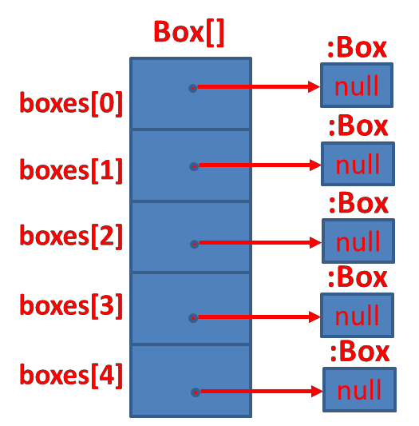
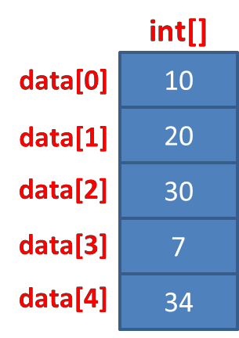
Primitive Type vs Object Type
Array
•
int[]
data
=
{
10,
20,
30,
7,
34
};
•
Box[]
boxes
=
new
Box[5];
•
String[]
names = {
“David”, “Ram”,
String[]
“Mike”};
:String
David
names[0]
:String
names[1]
Ram
:String
names[2]
Mike
12
Object-Oriented Programming Using Java

Slide 13
Thank
You
13
Object-Oriented Programming Using Java

